Slide 1
WiGiPedia
A Tool For Improving Structured Data in Wikipedia
Kainan Xu
29/02/2016

Slide 2
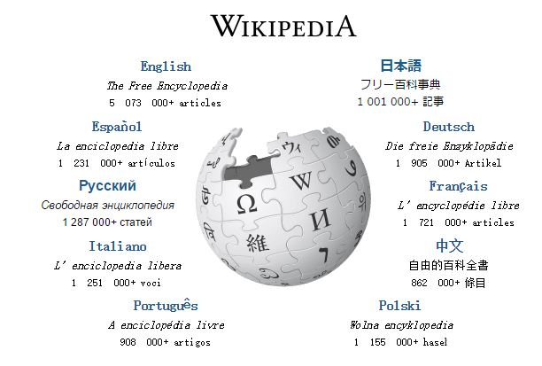
What's Wikipedia?
launched on January 15, 2001.
free-access, free-content Internet encyclopedia
largest & most popular general reference work.
38+ million articles in 250 different languages.

Slide 3
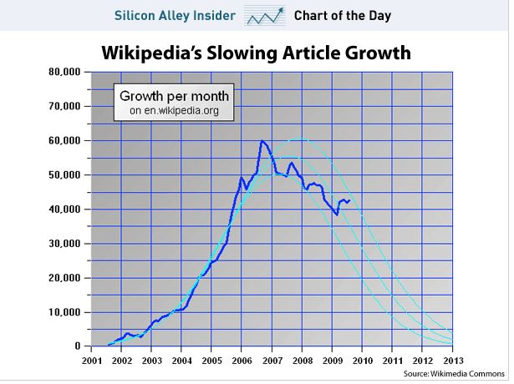
The problems of Wiki
falloff in the number of users providing meaningful contributions

Slide 4
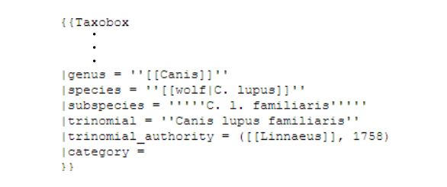
Reasons for the full off
1
more complex security policies
2
saturation of simpler articles
3
complicated interface and markup
Example of the existing infobox markup in Wikipedia

Slide 5
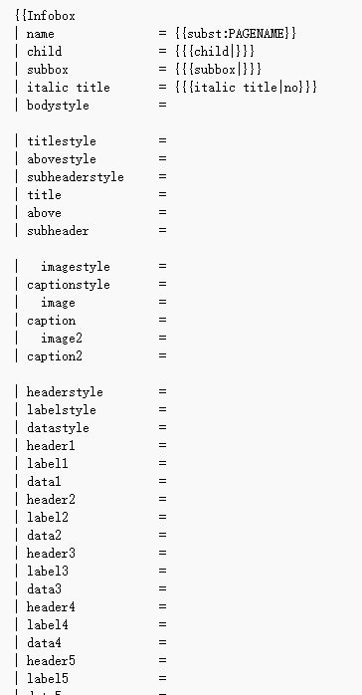
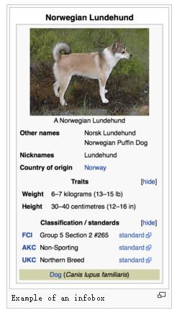
The problems of Wiki
infoboxes - more structured information
difficult to edit because of the arcane template syntax.

Slide 6
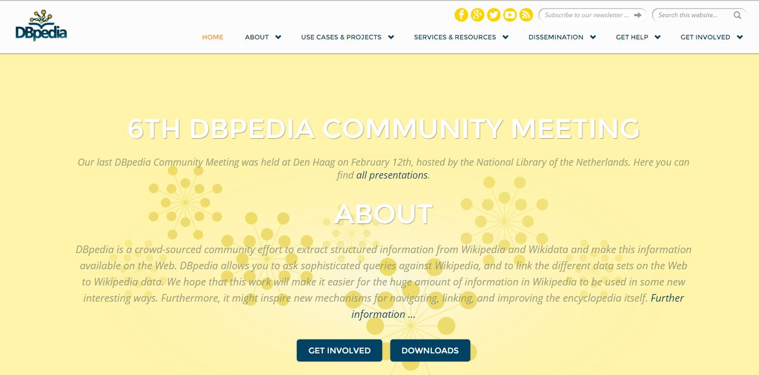
DBpedia
a semantic web resource
extract structured information from Wikipedia
a database of subject-object-predicate triples
queries against Wikipedia
problems
The resulting semantic data suffers from incompleteness and a variety of inconsistencies, which adversely impact results of complex queries over the data.

Slide 7
inconsistency
1
double meanings of terms. E.g.:Apple & Apple Inc
Ambiguity
2
entities can have multiple names or aliases. E.g.: United Kingdom, U.K., UK.
Multiple Naming

Slide 8
inconsistency
When multiple edges on anode have different relationship types, but originate from the same type/class of nodes
3
Inconsistent links
relations have not been provided in the Wiki.
4
Missing links
E.G.BOA & WF , industry, Financial Services
Wachovia, genre, Finacial Services
CitiBank, products,Financial Services
BOA, Wells Fargo, Wachovia -> United States
CItiBank ?-> United States

Slide 9
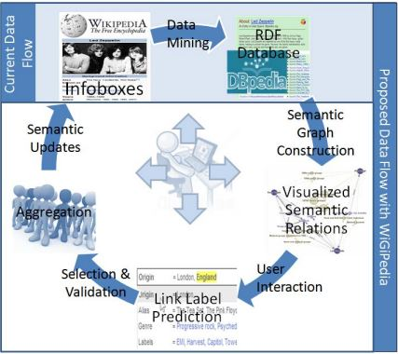
What's WiGipedia Do?
an interactive interface
easy-to-use tool for specific Wikipedia structured information
boost the consistency of structured data spread across Wikipedia articles

Slide 10
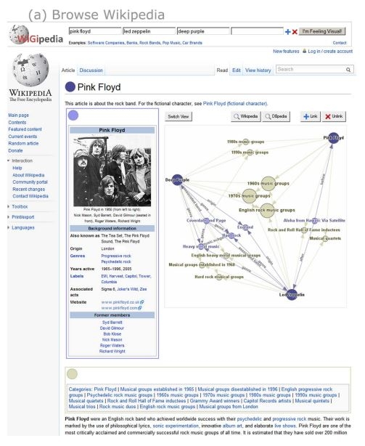
DESIGN AND IMPLEMENTATION
Data Generation
DBpedia-subject-predicate-object RDF triple
edges are directed & labeled with the RDF predicate
Graph View
Rendering an interactive web-based graph across browsers
two tiers of nodes

Slide 11
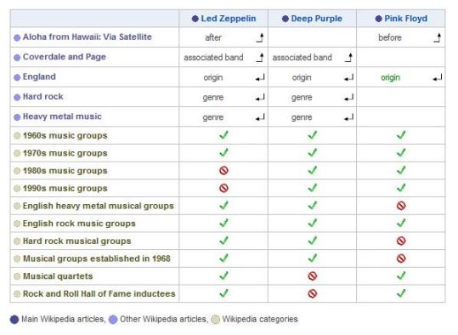
DESIGN AND IMPLEMENTATION
Table View
Designed to portray the exact same data set as the graph
Edge Labels
suggestions from Graph DBpedia & Wikipedia

Slide 12
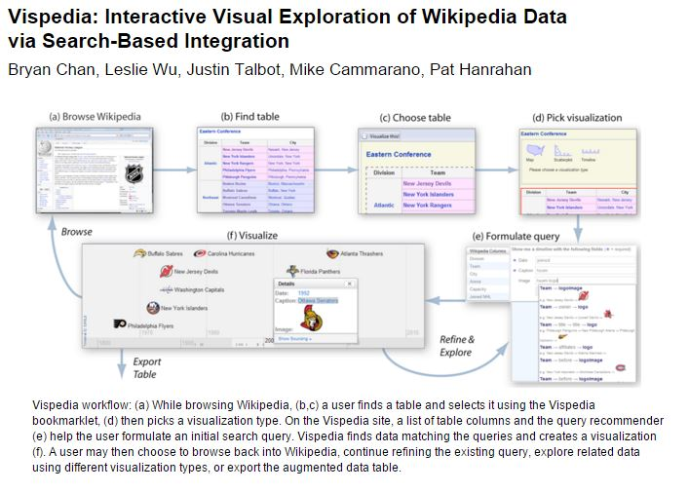
Compared to Vispedia
focusing on the gathering of rich semantic data & on visualization and editing of Wiki data
uses a interactive interface facilitating input of information

Slide 13
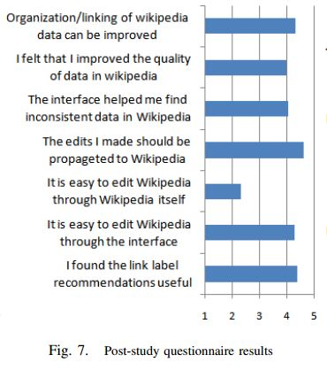
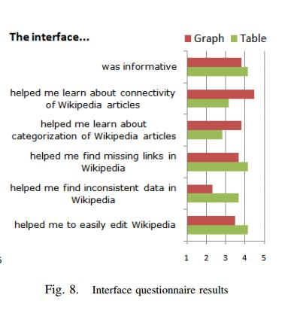
EVALUATION & CONCLUSION
User Study of 25 participants
Comparison with the standard Wikipedia editing mechanism
users readily understand the interface & can provide semantic updates in less time than is necessary for the existing Wikipedia interface.

Slide 14
THANK YOU

